Slide 1


A Project Based Learning-II (PBL-II) Presentation on
Automatic Attendance system using Face Recogniation
Presented by
Mr . Kakad Abhishek Satu | 23 | S190101526
Mr . Kale Abhishek Subhash | 24 | S190101527
Mr . Karle Rushikesh Shivshankar | 25 | S190101528
Mr . Kawade Ganesh Popat | 27 | S190101530
Mr . Mule Ashutosh Bhausaheb | 37 | S190101541
Under the Guidance of
Prof. Wakchaure P.B.
Amrutvahini College of Engineering, Sangamner

Slide 2
Contents
Introduction
Need For Project
Problem Statement/Aim
Objectives
Literature Review
Required Tools
Design Of Model
Methodology
Results Of Project And Discussions
Conclusion
Future Scope
References

Slide 3
Introduction
Automatic attendance system is automated version of physical presence of person without any manual interference.
Real-time face recognition algorithms are used and integrated with existing management system.
With advancements in parallel computing ,complex learning like face recognition are being used in todays time with loss error and high accuracy.

Slide 4
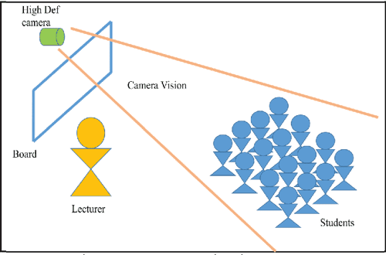
With advancements in parallel computing ,complex learning like face recognition are being used in todays time with lass error and high accuracy.

Slide 5
Need of the Project
Advantages of Attendance system using face Recognition
Great time Saver
Data will digitally saved
Track attendance any time of student
Real time status recording
Increases Accuracy
Information can send to parents

Slide 6
Problem Statement/Aim
Traditional method of attendance recording has proven to be stressfully and in effective.
Sometimes proxy attendance has been recorded by students.
To fill attendance in book becomes stressfull .
No transparency of attendance.
Aim-: to reduce the attendance time and attendance can digitally recorded in the form of datasheet.

Slide 7

Objectives
Automated update in the database without human intervention
Calculate the attendance subject wise.
Avoiding the time losses during class started.
Provide a valuable attendance service for both teachers and students.

Slide 8
Literature Review
Sr. No | Authors | Name of Topic | Major Findings
1 | D . Gupta and S . Choubey | Face Recognition based attendance system | “ Discrete wavelet transform for image processing “
2 | S . E . Handy , S . Lukas and H . Margaretha | Automatic attendance system using face recognition | “ Further tests for face recognition using discrete cosine transform and hidden Markov model “
3 | Radhika C . Damale , Prof.Bageshree V. Pathak. | Attendance manegement system using face recognition | “ Face recognition Based attendance system using machine Learning Algorithms “
4 | Dhanush Gowada , K vishal , Keertiraj.B.R | Face Recognition based attendance system | Automated attendance , image processing face detection
5 | Sager Chanchal , Tanmay Desai | Attendance management system using face recognition | Attendance , Facial recognition & detection , open CV-Python

Slide 9
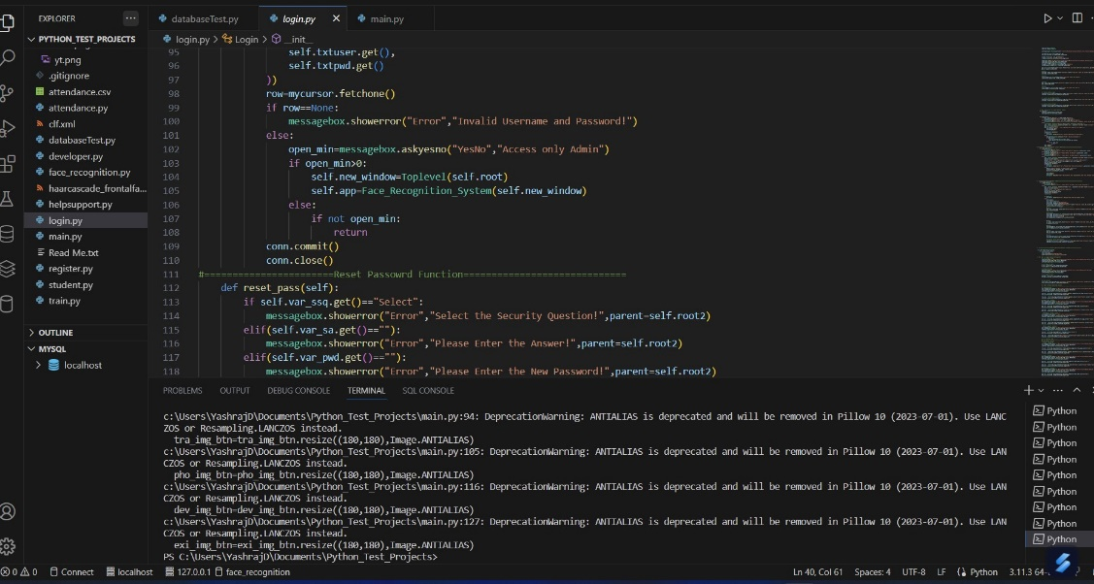
Required tools
In this project we had used the following tools for face recongnition and data storage of process:-
Visual Studio code Software:
We used this software for creating login page and controlling page that makes this system easy to operate and as well as easy to connect it to other Softwares.

Slide 10
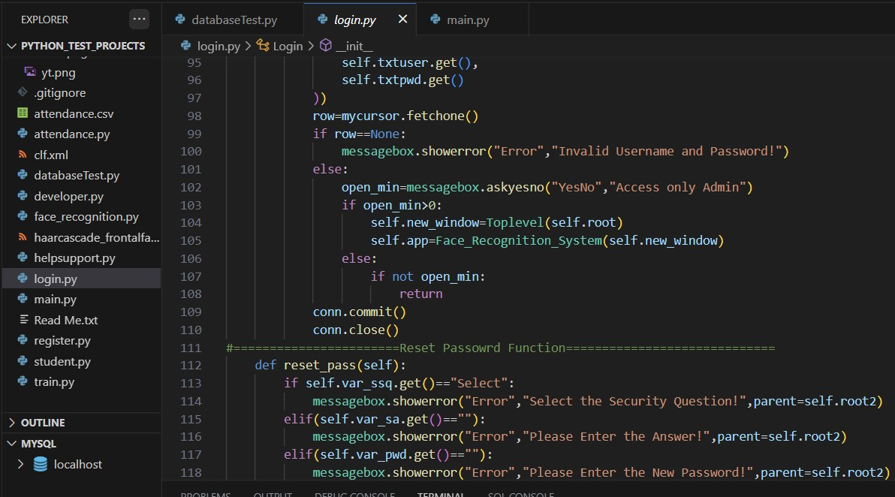
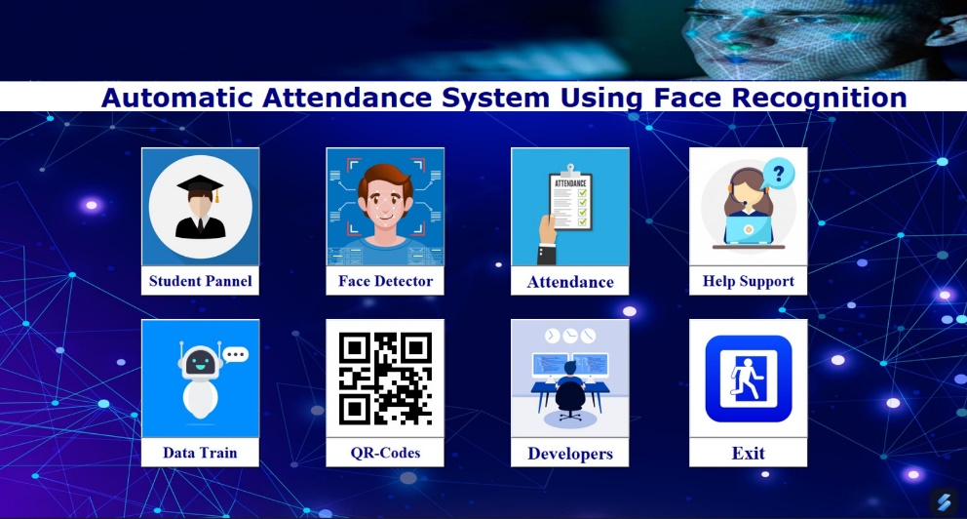
Required tools
Python language:
It is being used in visual studio code with our available knowlage about python language to create the interface.
By programming the visual outcome

Slide 11
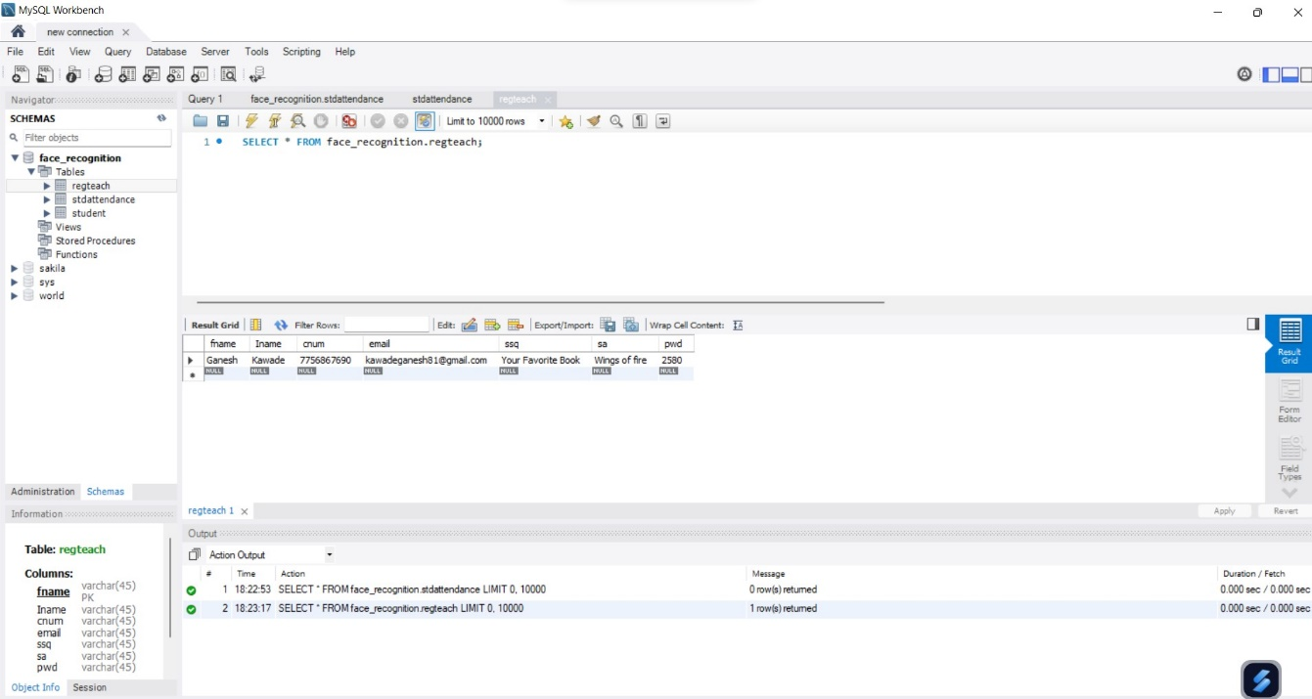

Required tools
my SQL Workbench:
This is used to creates the create the columns for storage that stores students details as well as marks the attendance in proper way.

Slide 12
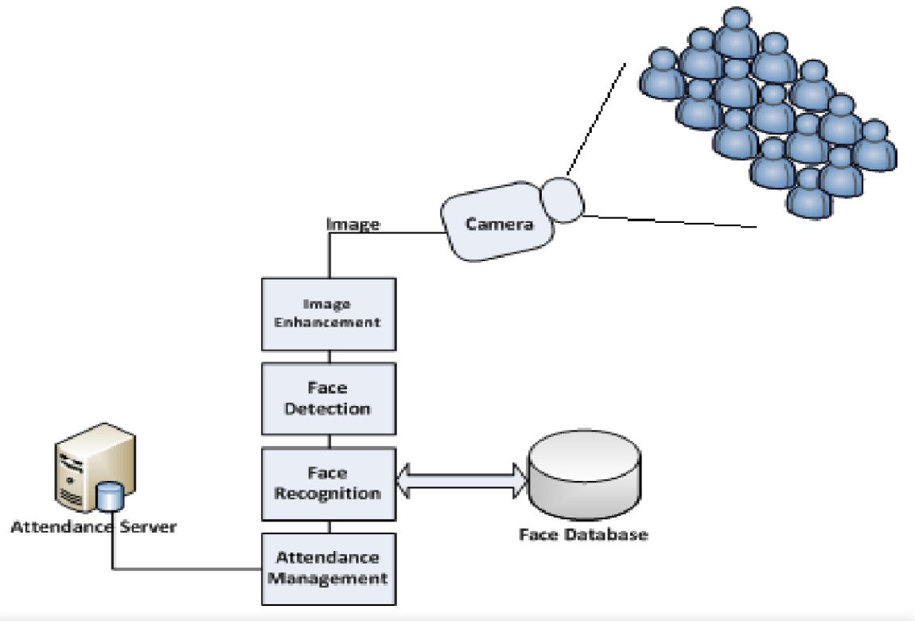
Design of model

Slide 13
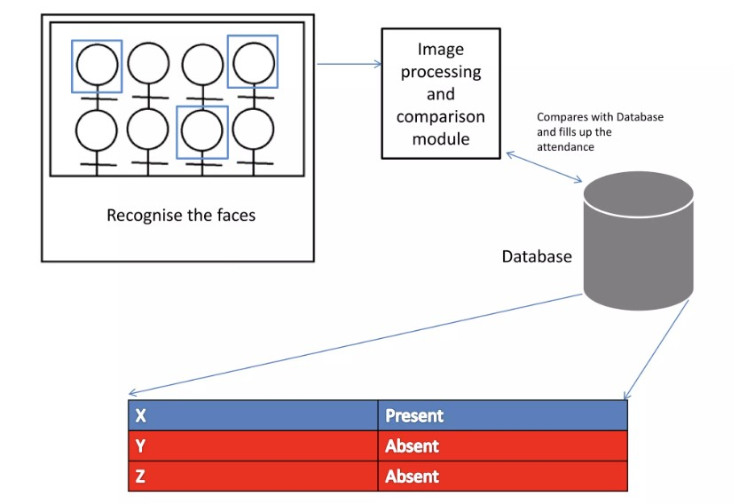
methodology
Take Attendance

Slide 14
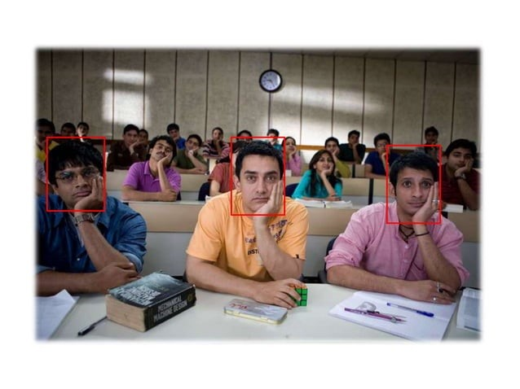
methodology
Role of the students:

Slide 15
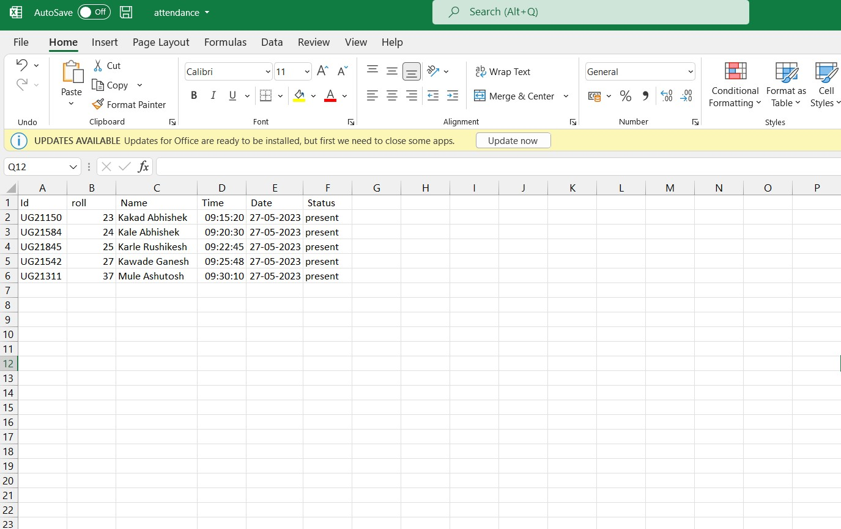
methodology
After capturing all faces it saves the attendance in excel sheet with Timing with status

Slide 16
Results and discussions
As an automated attendance-management system, facial recognition provides precise time records
Reducing costly mistakes.
Easy Process.
Gives accurate datasheet of students.
Digital data is being saved.
Saves attendance time of teachers.

Slide 17
Future scope
Can be deployed for verification and attendance tracking at various colleges ,government offices and corporations.
Access control verification and identification of authentic users it can also installed in bank lockers and vaults.
For identification of criminals the system can be used by police force.
Also find missing person in our society.

Slide 18
Conclusion
An automatic attendance system is an educational ERP system that records the students' attendance in an institution. Unlike the conventional attendance system, the automatic attendance software enables the faculty to record, store, and monitor students' attendance history & manage the classroom efficiently.

Slide 19
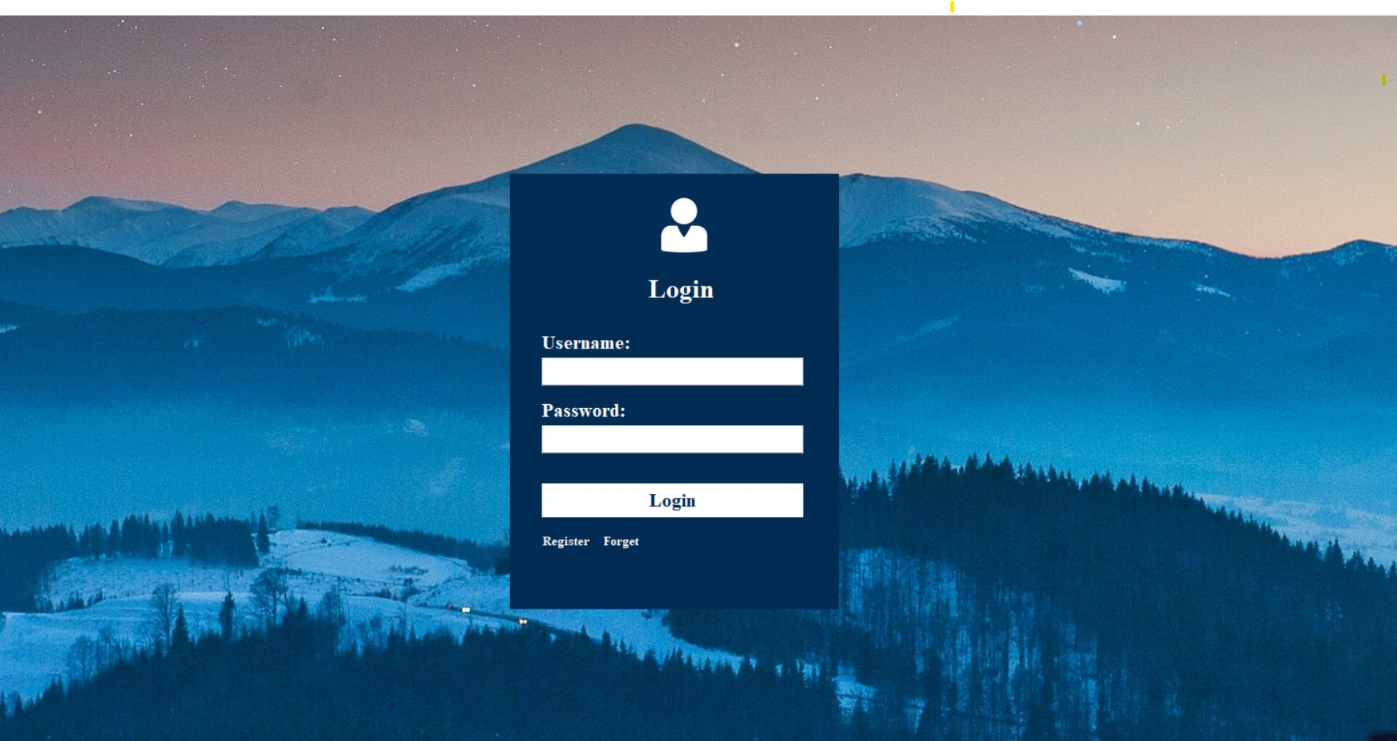
Photos

Slide 20
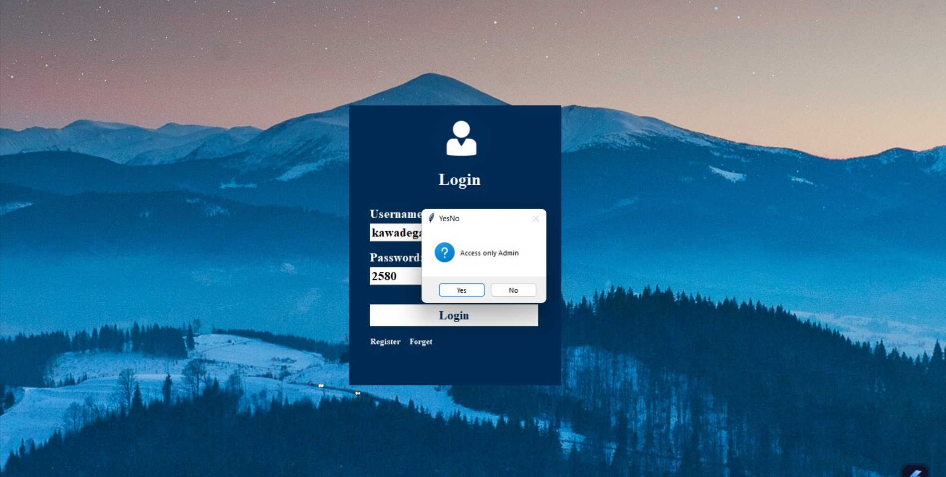
Photos

Slide 21

Photos

Slide 22
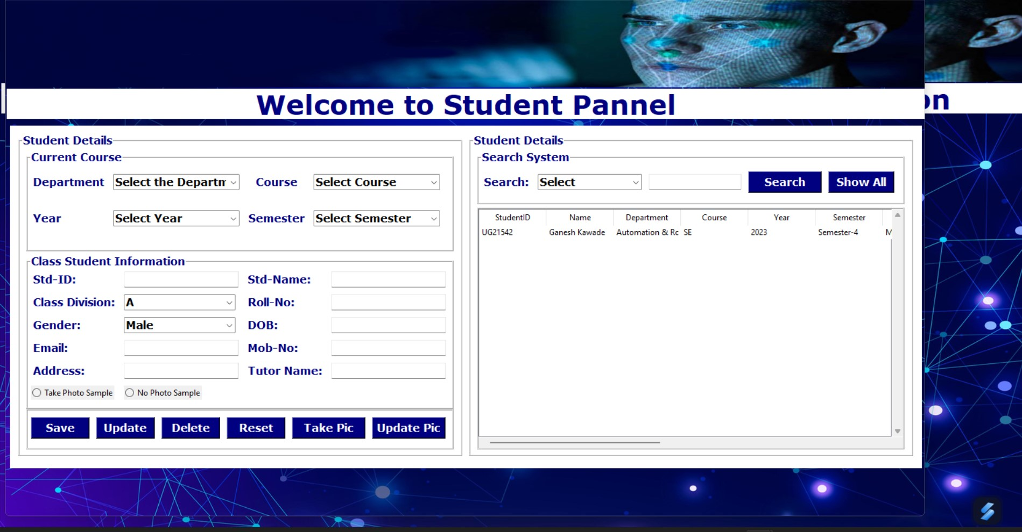
Photos

Slide 23
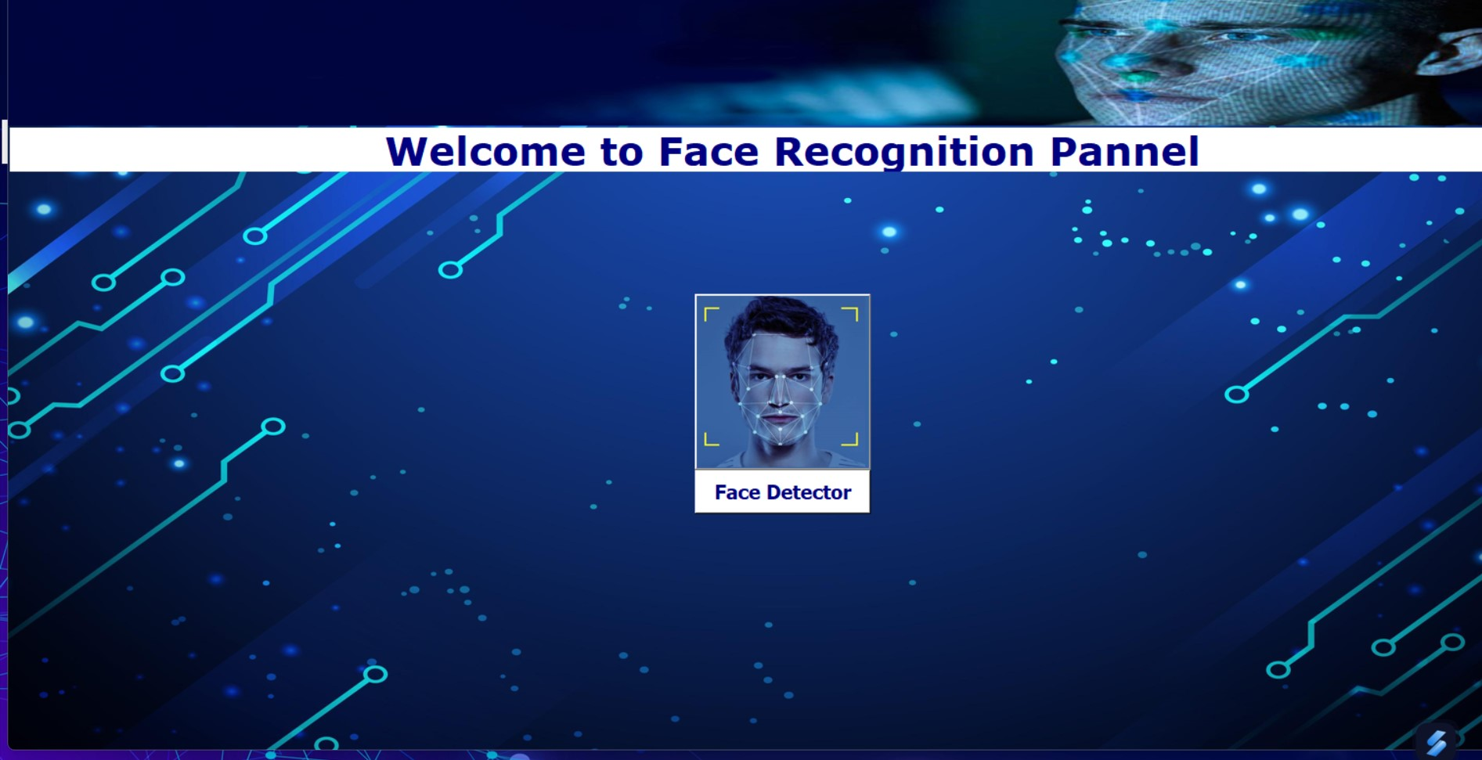
Photos

Slide 24
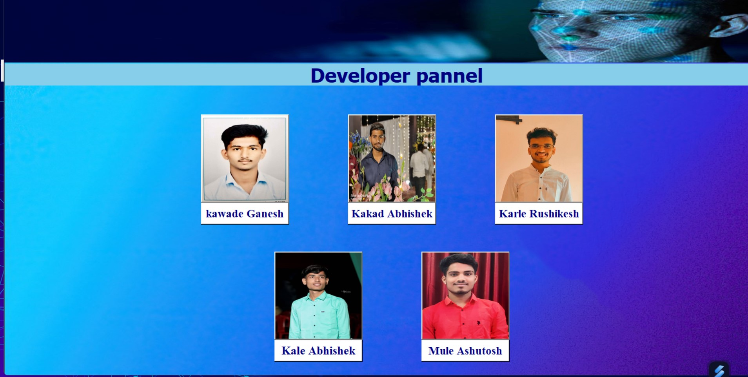
Photos

Slide 25
References
D. Gupta And S. Choubey, “Discrete Wavelet Transform For Image Processing,” International Journal Of Emerging Technology And Advanced Engineering, Vol. 4, Issue 3, March, 2015.
S. E. Handy, S. Lukas, And H. Margaretha, “Further Tests For Face Recognition Using Discrete Cosine Transform And Hidden Markov Model,” In Proc. International Conference On Electrical Engineering And Informatics (MICEEI), Makasar, 2012.
Radhika C.Damale, Prof.Bageshree.V.Pathak.“Face Recognition Based Attendance System Using Machine Learning Algorithms." Proceedings Of The Second International Conference On Intelligent Computing And Control Systems (ICICCS 2018) IEEE Xplore Compliant Part Number: CFP18K74-ART; ISBN:978-1-5386- 2842-3. Ieee 2018.
S. Kadry And K. Smaili, “A Design And Implementation Of A Wireless Iris Recognition Attendance Management System”, Information Technology And Control, Vol. 36, No. 3, Pp. 323–329, 2007
B. Bhanu, X. Tan, “Learned Templates For Feature Extraction In Fingerprint Images”, Proceedings Of The IEEE Conference On Computer Vision And Pettern Recognition, Vol.2, 2001, Pp.591-596.
T. Lim, S. Sim, And M. Mansor, “Rfid Based Attendance System”, In Industrial Electronics & Applications, 2009. Isiea 2009. IEEE Symposium On, Vol. 2. IEEE, 2009, PpO.
HTTPS://WWW.RESEARCHGATE.NET/PUBLICATION/367476432_vIRTUAL_tEACHING_aSSISTANT_FOR_cAPTURING_fACIAL_AND_pOSE_lANDMARKS_OF_THE_sTUDENTS_IN_THE_cLASSROOM_uSING_dEEP_lEARNING

Slide 26
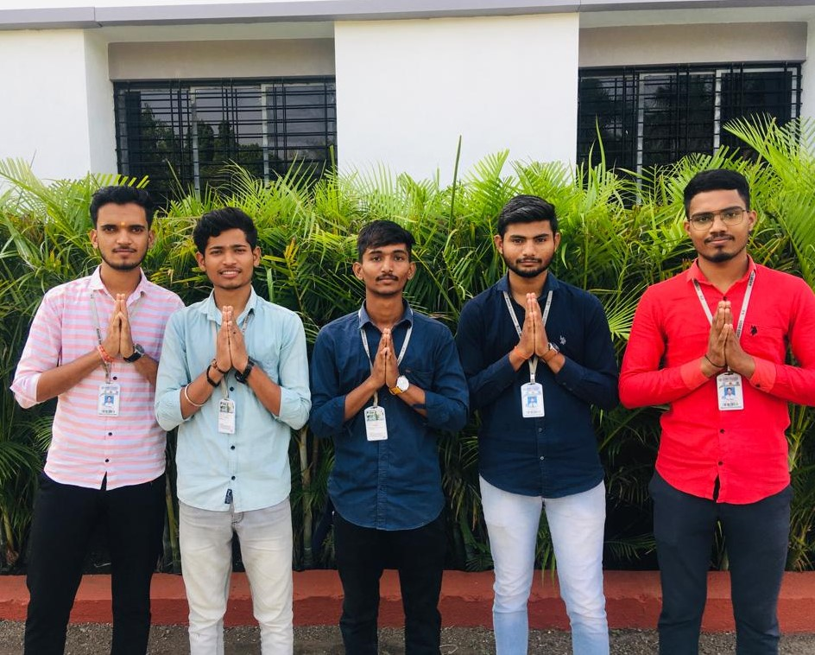
Thank you

